Slide 1
ROCO218: Control Engineering Dr Ian Howard Lecture 8 Real inverted pendulum practical

Slide 2
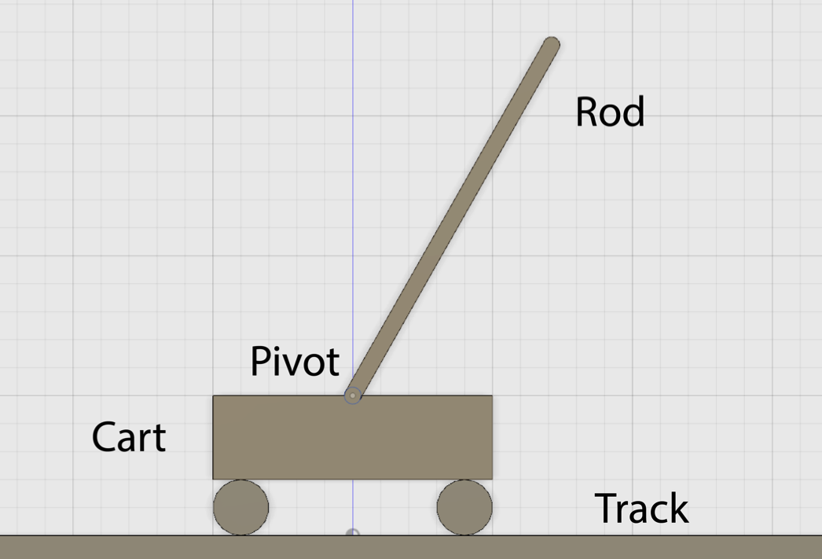
Inverted pendulum main components
By moving the cart to the left and the right it is possible to balance the pole and keep it upright

Slide 3
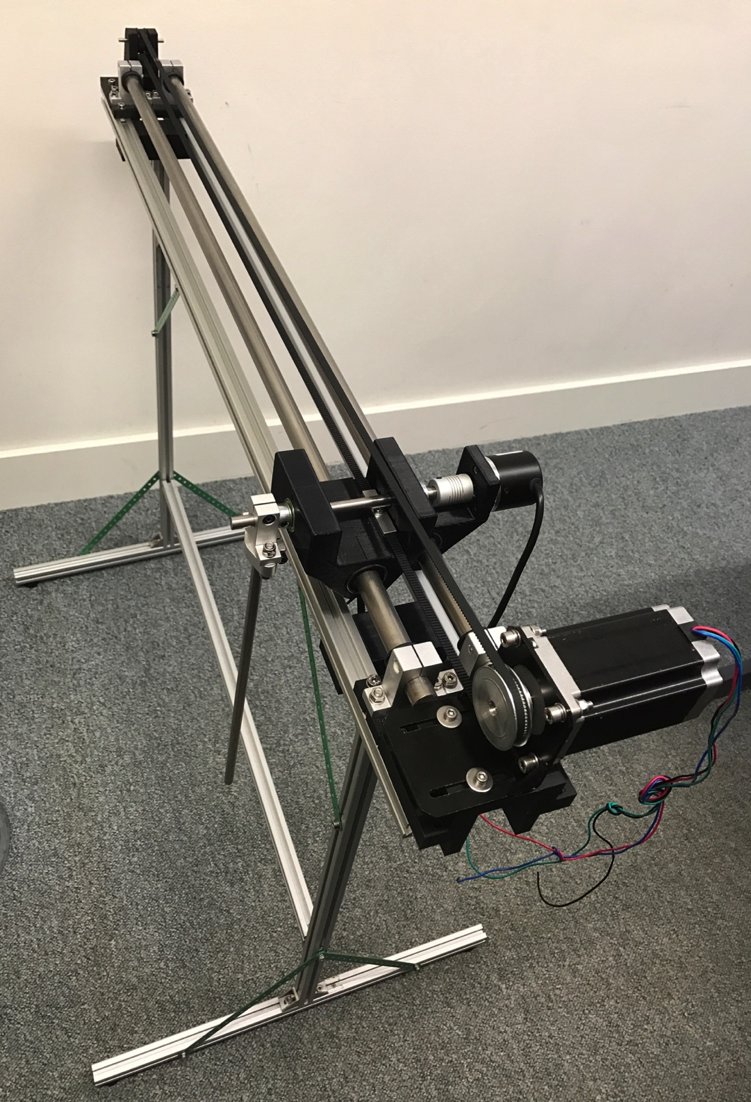
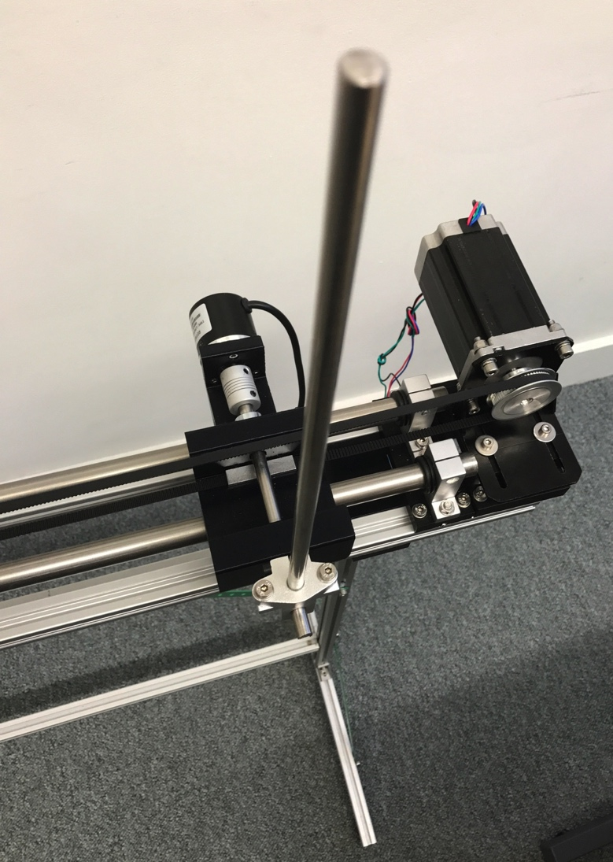
Pendulum system mounted on its aluminum profile stand
Stand allows the pendulum to rotate freely and avoid collisions.
Pendulum system with the rod shown vertically in its unstable position

Slide 4
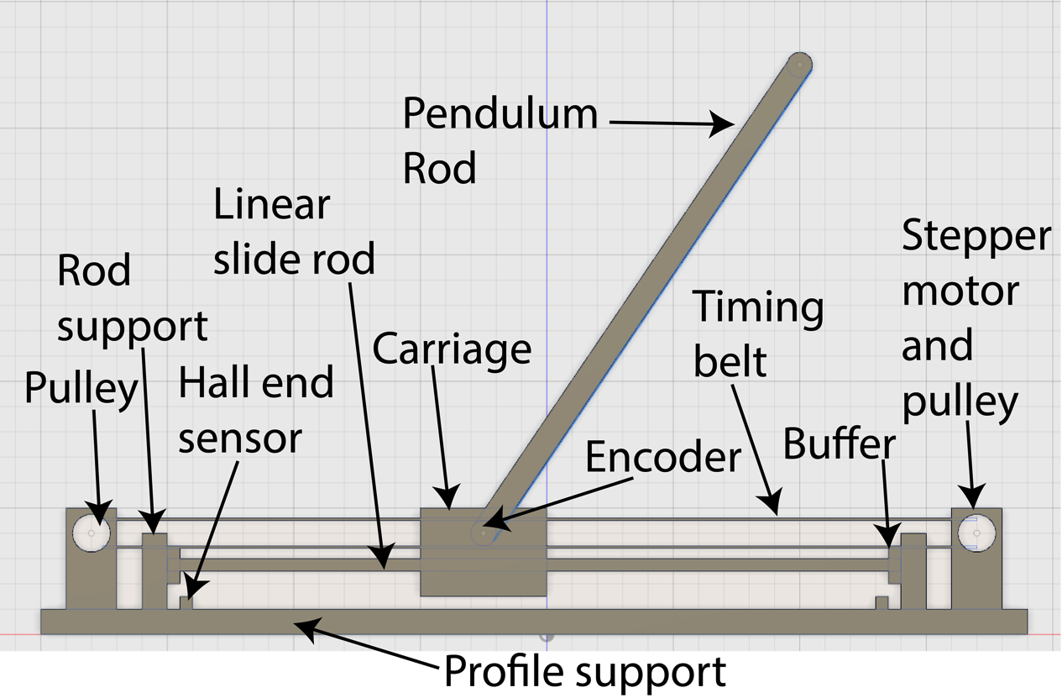
Inverted pendulum main components

Slide 5
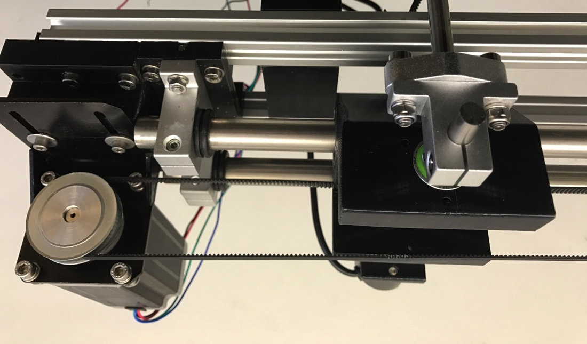
Pendulum drive motor and carriage mechanism
The drive pulley attached to the the stepper motor can be seen on the right and the attachment clamp for the pendulum rod can be seen on the left.

Slide 6
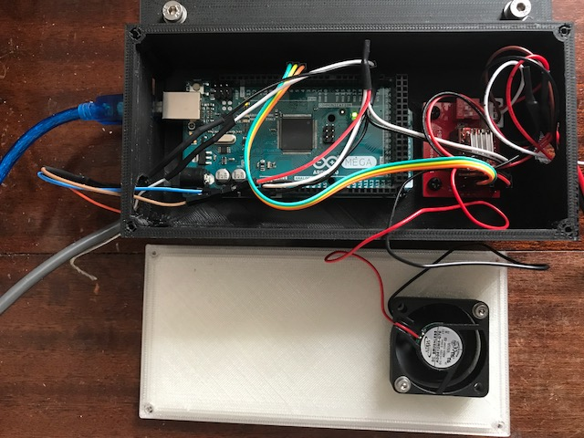
Inverted pendulum microcontroller and stepper driver
Arduino Mega
A4988 Stepper Motor Controller
USB
connection
Cooling fan on lid

Slide 7
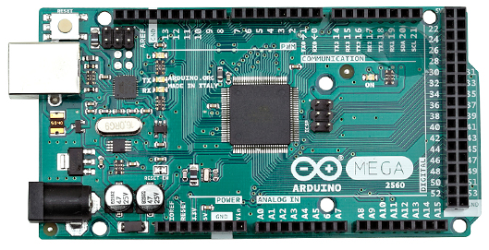
Arduino Mega connections
Digital I/O
USB input
Power outputs
Analog inputs
Encoder attached to DI interrupt pins: encoderPinA = 18, encoderPinB = 19
Hall sensors attached to DI interrupt pins: HallSensorLeft = 20, HallSensorRight = 21
Stepper controller attached DO to pins: dirPin = 4, stepPin = 5, enPin = 6

Slide 8
Arduino Mega summary
Microcontroller ATmega2560
Operating Voltage 5V
Input Voltage (recommended) 7-12V
Power via the USB connection
Digital I/O Pins 54
Digital I/O Pins which provide PWM output 15
Digital I/O Pins which provide interrupts 6
Analog Input Pins 16
DC Current per I/O Pin 40 mA
DC Current for 3.3V Pin 50 mA
Operate at 5 volts
Pins have internal pull-up resistor (disconnected by default) of 20-50 kOhms
Flash Memory (of which 0.5 KB used by bootloader) 256KB
SRAM 8 KB
EEPROM 4 KB
Clock Speed 16 MHz
Reason we need Mega and cannot use Uno

Slide 9
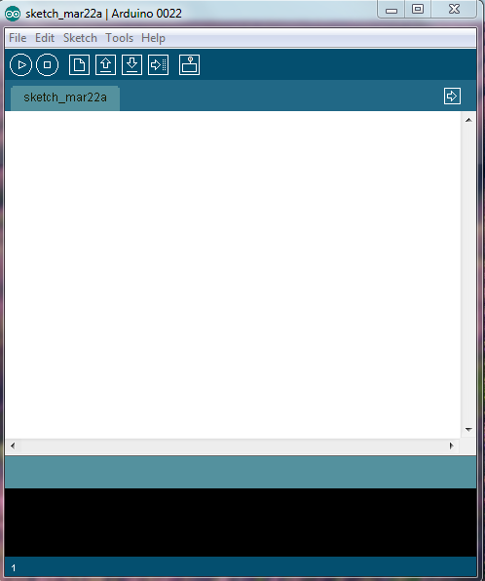
How to start coding: Software setup
Open the Arduino main window shown on the left
Download is available at www.arduino.cc
Use a USB A to B cable to plug you computer into the Arduino
Setup the port connection
Setup the board type
Editor input area

Slide 10
Programming the Arduino
Arduino’s programming language is a version of C
Most C commands work in the sketch editor
Four basic components of Arduino program
Initialization
Setup
Loop
User defined functions
Arduino Mega is designed to allow it to be reset by software running on a connected computer

Slide 11
Programming the Arduino: Initialization
Include any extra libraries you are using
All variables need to be initialized
A=4; will not work int a= 4; will
Define variables you will assign later
Int a,b,c;
Remember data structures
Int, double, float, char, string ….

Slide 12
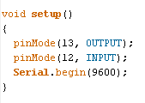
Programming the Arduino: setup
Initialization for the Arduino board
Usually begin serial communication
Usually assign digital pins to input or output
For example:
Void means setup will not output anything
pinMode defines the state of digital pins to OUPUT or INPUT.
Serial.begin(9600) opens serial communication at 9600 baud

Slide 13
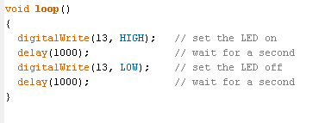
Programming the Arduino: loop
Loop is the main portion of the Arduino code
Loop is what the microcontroller will do forever
This is very much like a never ending for loop

Slide 14
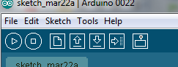
Compiling and uploading code
Compile
Upload
Serial Monitor
Under tools make sure Board is the board you and using and Serial port is checked and is the correct port

Slide 15
ROCO218: Control Engineering Dr Ian Howard Lecture 8 Simple Arduino example programs implementing functionality needed to control the inverted pendulum

Slide 16
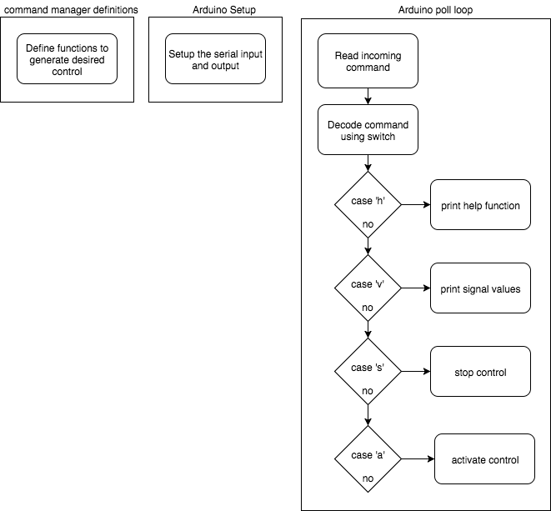
Menu control test program flow chart
Look at example Arduino program:
ProcessControlTest.ino

Slide 17
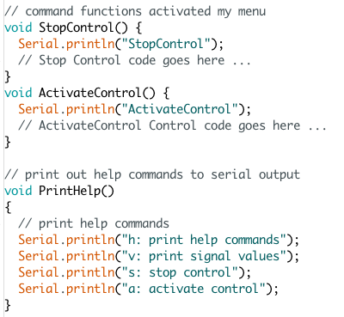
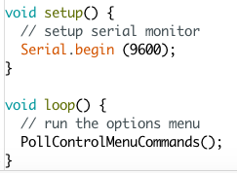
Menu control test program
Define functions that are called to generate desired control
Define function to print out menu options on request
Arduino setup function
Setup the serial output
Arduino loop function
Process commands

Slide 18
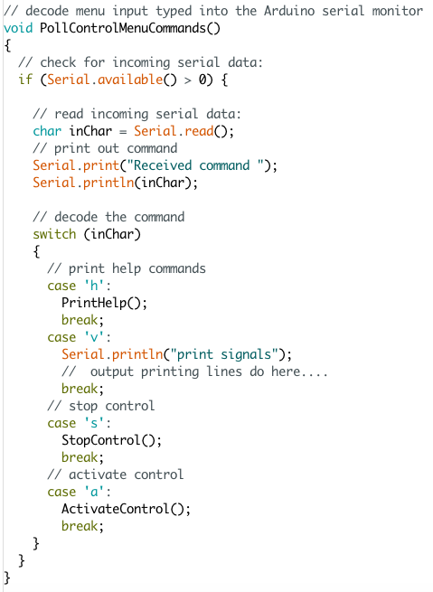
Menu control test program
If there is an incoming command
Read command and display it
Use a switch function to decode the command and call the appropriate command function

Slide 19
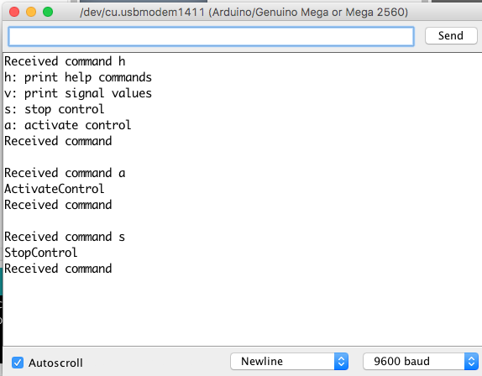
Menu control test program

Slide 20
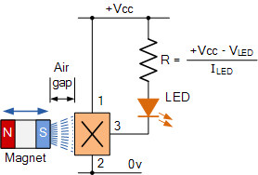
Hall effect magnetic sensor circuit
Simple switch activated by the application of a magnetic field
When south pole of magnet brought up to this sensor, LED is switched on

Slide 21
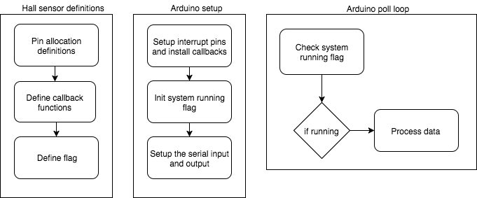
Shutdown control using Hall sensor flow chart
Look at example Arduino program:
SimpleHallSensorTest.ino

Slide 22
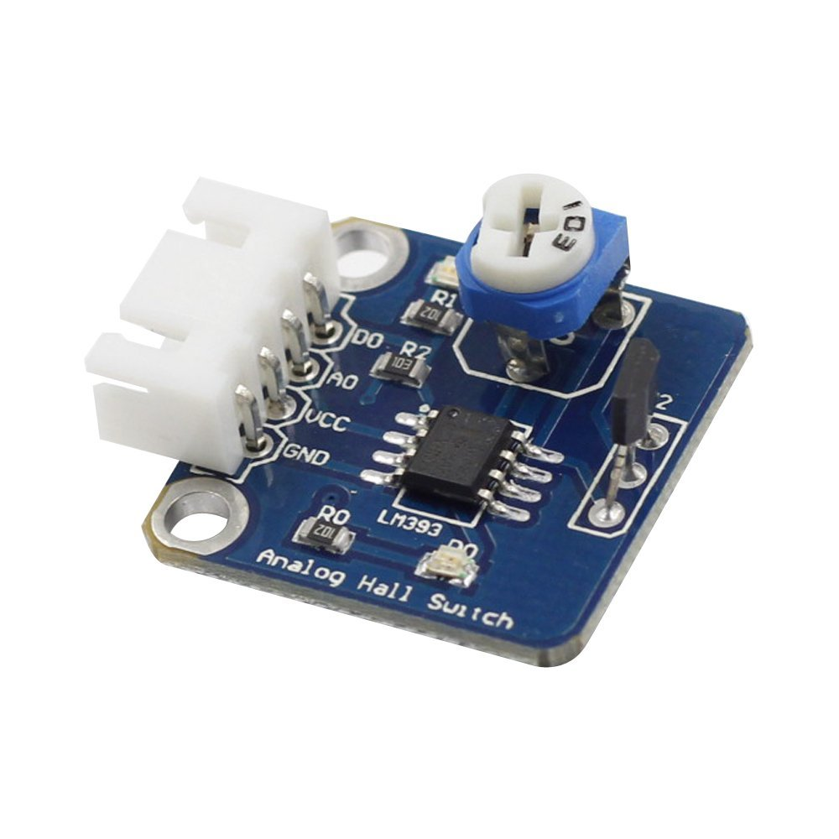
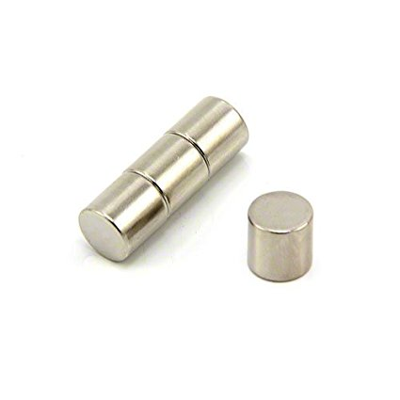
Shutdown control using Hall sensor limit switches
Sensors need to stop control when pendulum carriage reaches its
end of travel to the left and to the right
Hall sensors activated by neodymium magnet on carriage
SunFounder Analog Hall Switch Sensor Module
0v to GND
+5v power to VCC
Digital output on D0
Neodymium magnet on carriage

Slide 23
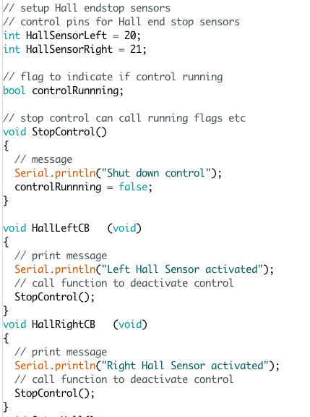
Shutdown control using Hall sensor limit switches
Define digital inputs
Use pins that support interrupts
Define flag
Define control stop function
Left sensor callback function
Right sensor callback function

Slide 24
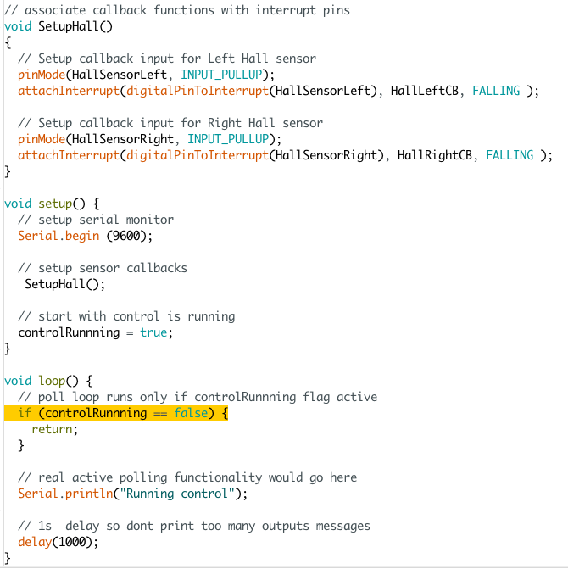
Shutdown control using Hall sensor limit switches
Associate Hall callbacks with pins
Arduino setup function
Use serial interface
Setup Hall sensors
Enable processing
Arduino loop function
Only perform processing if flag active
Processing goes here

Slide 25
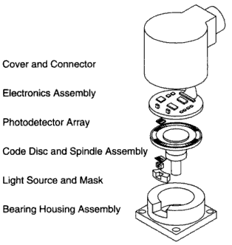
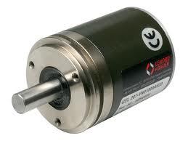
Digital incremental encoder
Generates a relative position signal suitable for positioning tasks
Rotation direction recognition
Speed information from number of pulses per time unit
Standard solution for many applications
Single output types only used to determining the speed

Slide 26
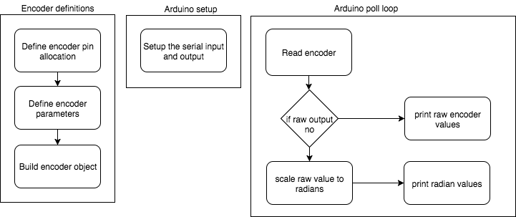
Read encoder flow chart
Look at example Arduino program:
SimpleEncoderTest.ino

Slide 27
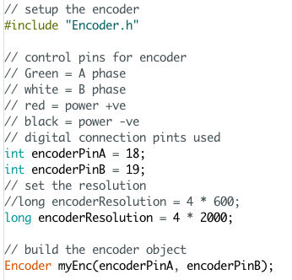
Arduino incremental encoder test program
Include the encoder class
Define digital input pins that support interrupts to connect to encoder
Build the encoder object as global variable

Slide 28
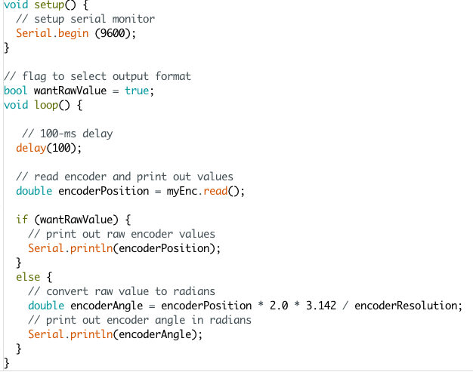
Arduino incremental encoder test program
Arduino setup function
Use serial interface
Arduino loop function
100ms delay so doesn’t run too fast
Read encode
Choose output format
Print out raw encoder count
Print out angle in radians

Slide 29
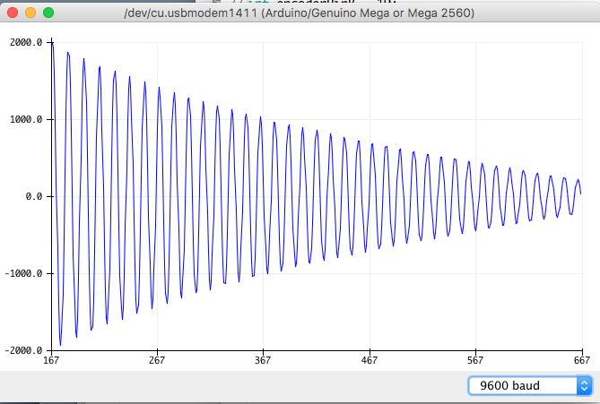
Arduino incremental encoder test program
Plot output using serial monitor

Slide 30
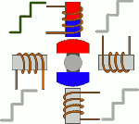
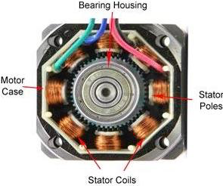
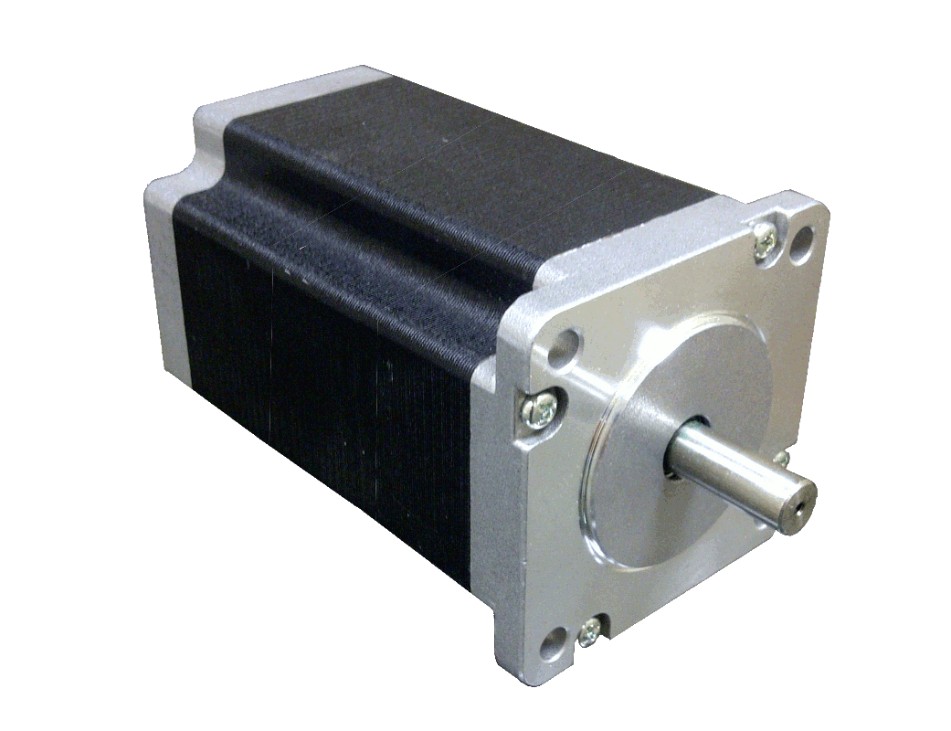
Microstep stepper motor control
Use micro step mode
This implements a gradual transition between pole positions
This leads to smoother operation that full-step
Microstepping

Slide 31
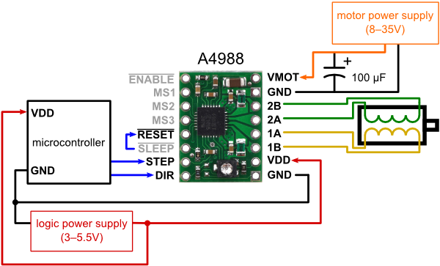
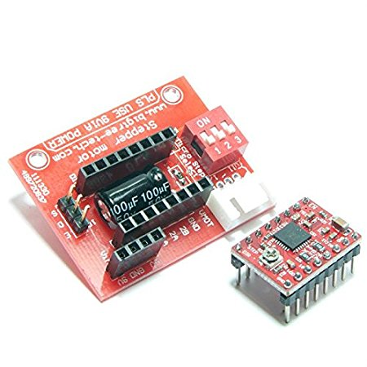
A4988 Stepper Motor Controller
Stepper shield
Intelligent current control up to 2A
Set stepping mode via control pins – set to 4x micro stepping
Simple step and direction control interface
To operate: Need to generate
control pulses (1 pulse per micro step)
direction signals (so motor turns in desired direction)
https://www.pololu.com/product/1182

Slide 32
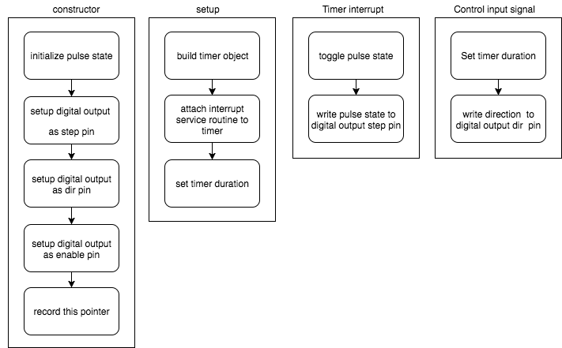
CStepper velocity control class flow chart

Slide 33
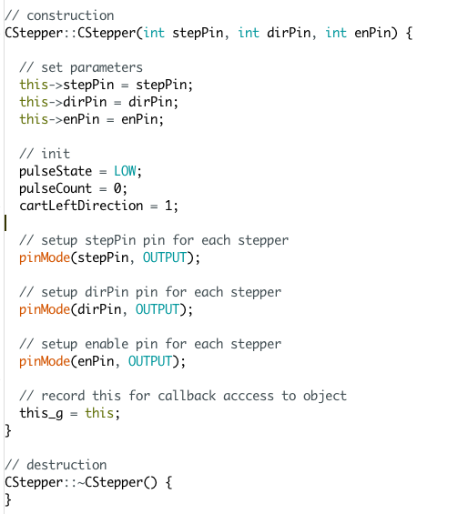
CStepper velocity control class flow chart
Define pins used for stepper
Define signals variables
Setup digital output pins
Record this pointer
needed for callback

Slide 34
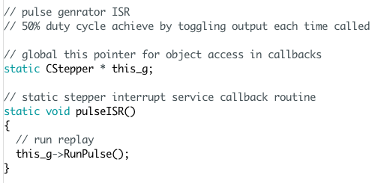
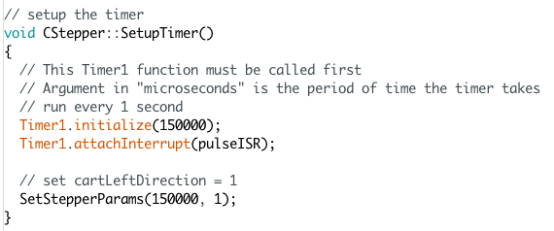
CStepper velocity control class flow chart
Define this pointer
Define interrupt service routine that will generate pulses
Setup a timer
Attach interrupt routine that will be called by timer

Slide 35
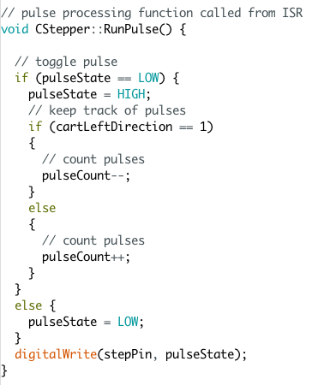
CStepper velocity control class flow chart
Pulse generation function
Toggle pulse state
Inc or dec pulse count depending on direction
Write pulse state to digital output

Slide 36
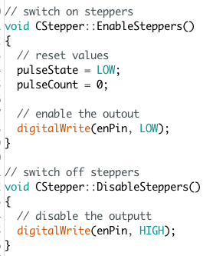
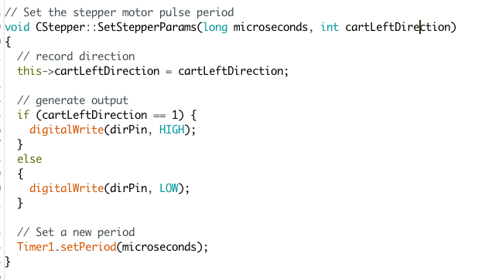
CStepper velocity control class flow chart
Enable the stepper
Disable the stepper
Stepper Function
Set stepper direction
set timer period

Slide 37
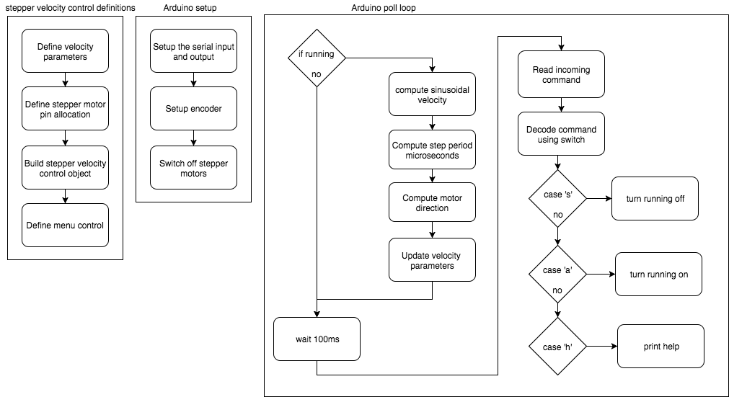
Arduino stepper velocity control flow chart

Slide 38
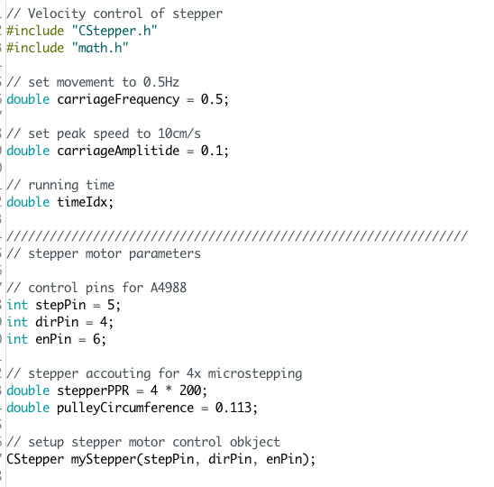
Arduino stepper velocity control test program
Include the stepper class
Define the movement parameters
Define the encoder pins
Define stepper motor parameters
Build the velocity control stepper motor object

Slide 39
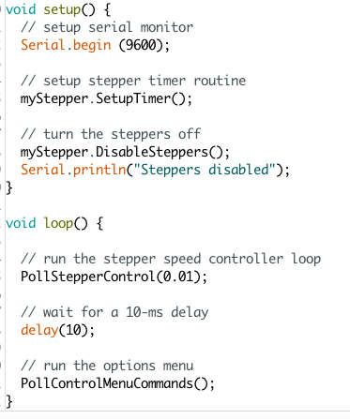
Arduino stepper velocity control test program
Arduino setup function
Setup serial I/O
Setup timer
Turn off the steppers to start with
Arduino loop function
Regularly poll the stepper control
Put in 10ms delay
Regularly poll the command manager

Slide 40
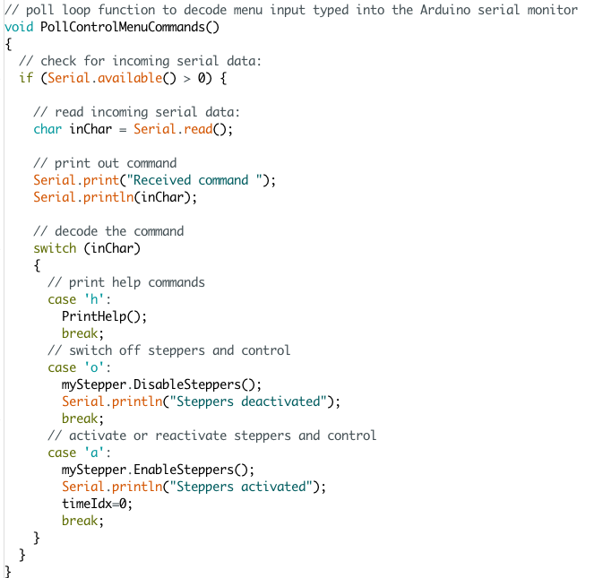
Arduino stepper velocity control test program
Poll function for command manager
Read and echo back incoming command
Decode the commands
Report help option
Switch off stepper option
Switch on stepper option

Slide 41
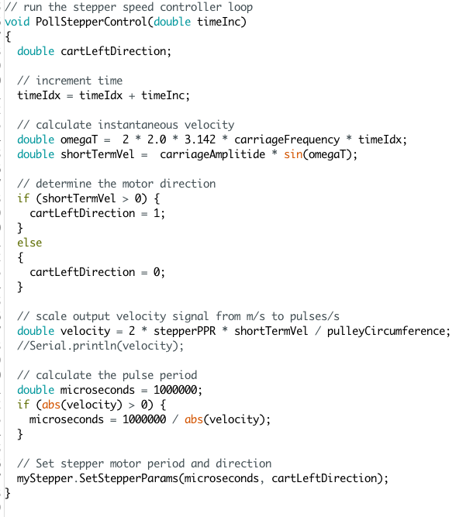
Arduino stepper velocity control test program
Poll function for stepper speed generation
Calculate current sine wave modulated output velocity
Determine motor direction
Determine stepper pulse period needed
Use the pulse period and direction

Slide 42
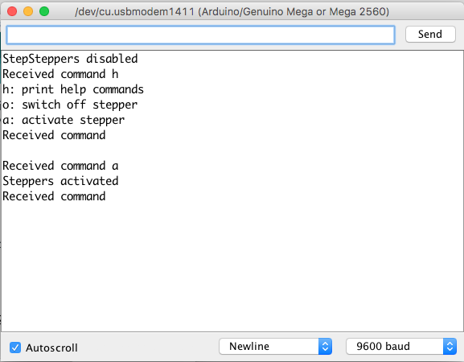
Arduino stepper velocity control test program
Look at example Arduino program:
StepperVelocityTest.ino

Slide 43
CSFC3 class control flow chart

Slide 44
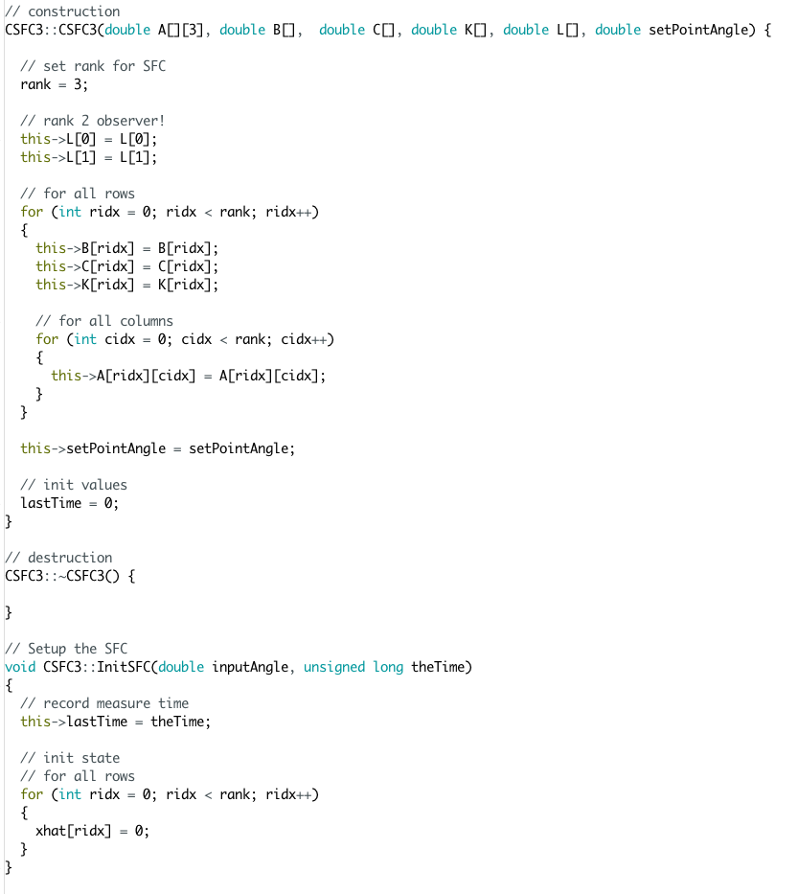
SFC with observer C++ implementation

Slide 45
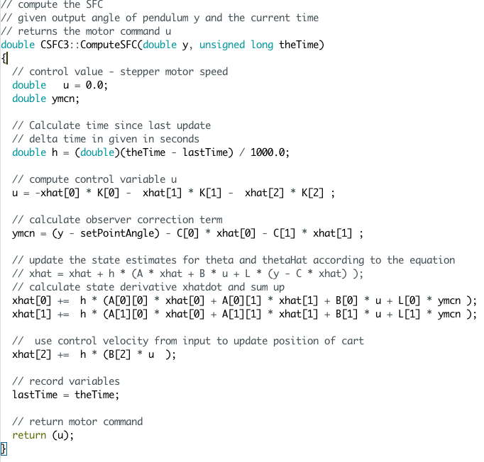
SFC with observer C++ implementation

Slide 46
SFC inverted pendulum control flow chart

Slide 47
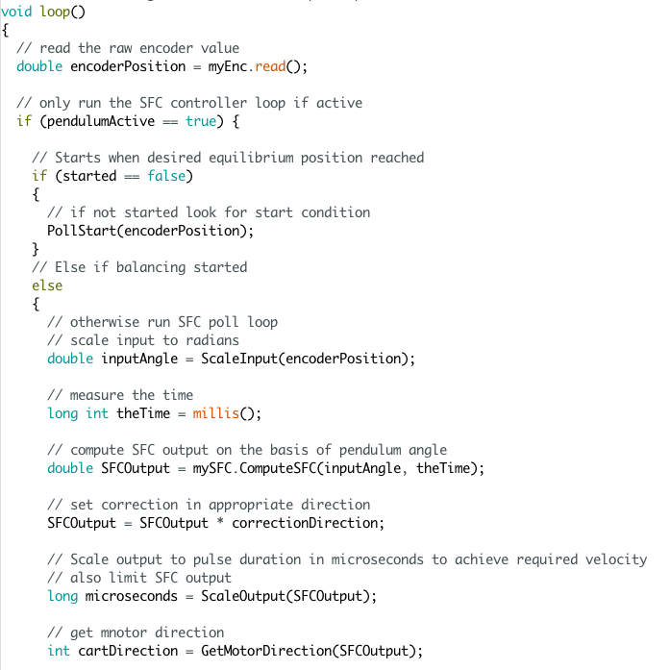
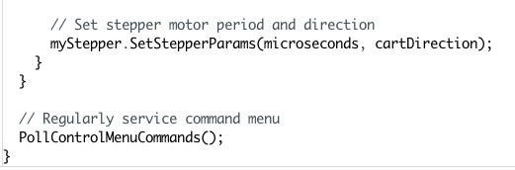
Arduino inverted pendulum state space control
Arduino loop function
Read encoder
If system active proceed
If balancing not started
look for start
Else if balancing started
Scale encoder input and get time
Compute SFC controller output
Compute pulse period and motor direction
Set desired motor speed and direction
Regularly service command menu

